Slide 1


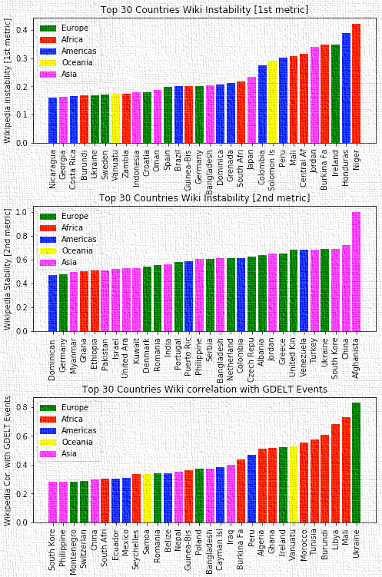
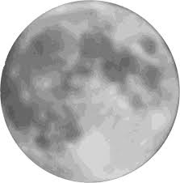
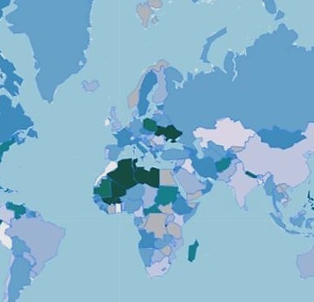
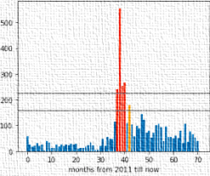


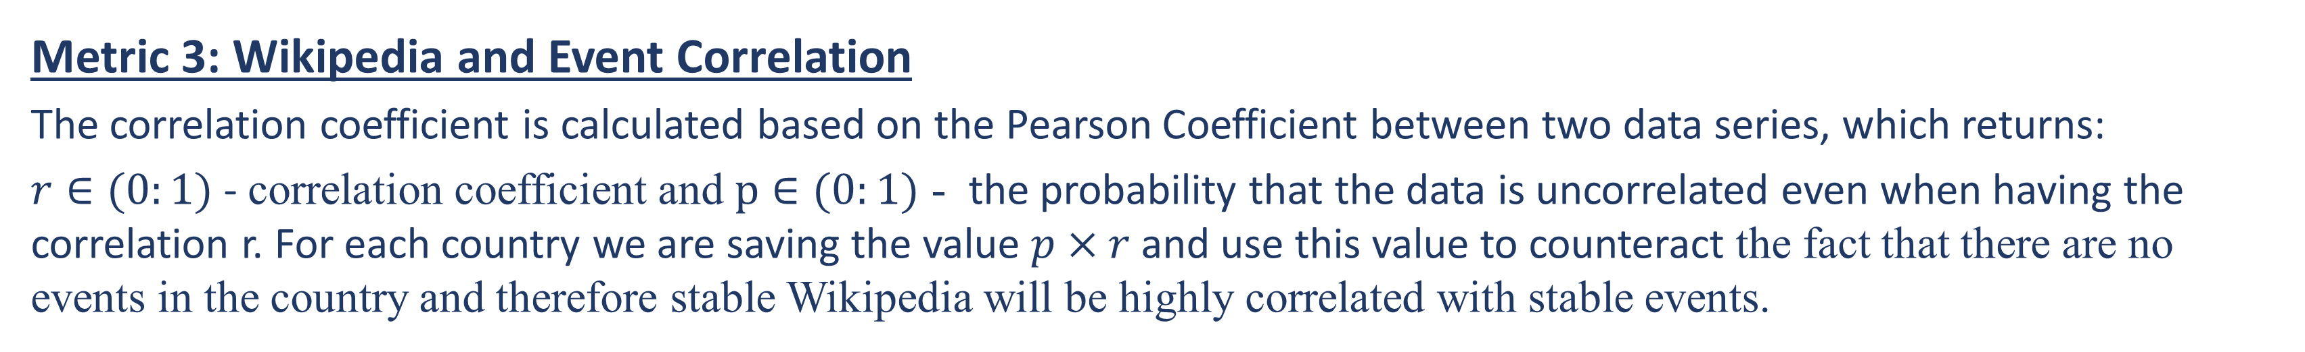
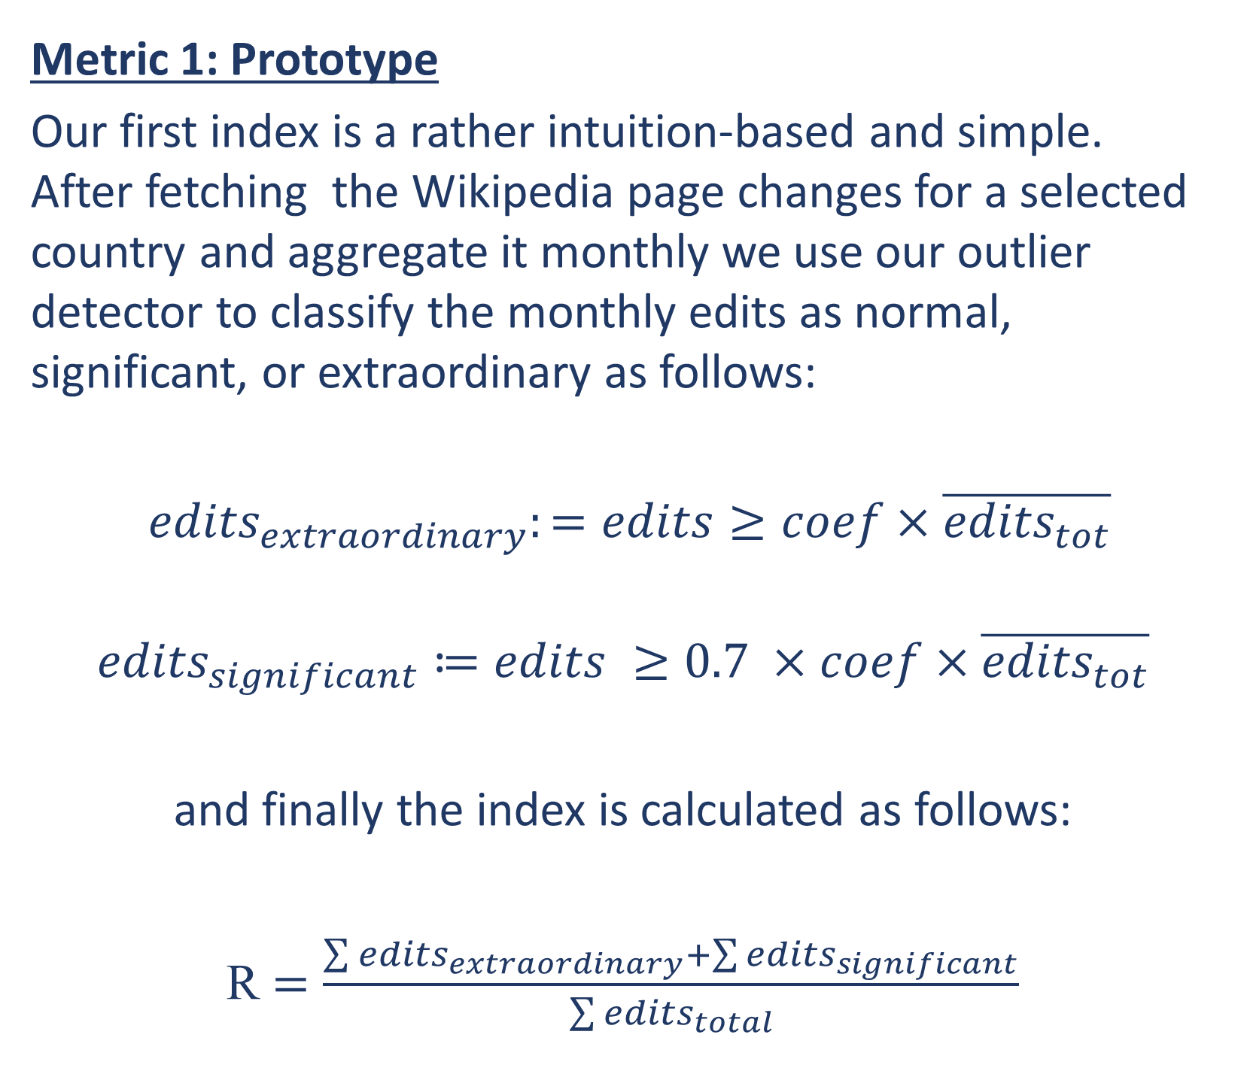
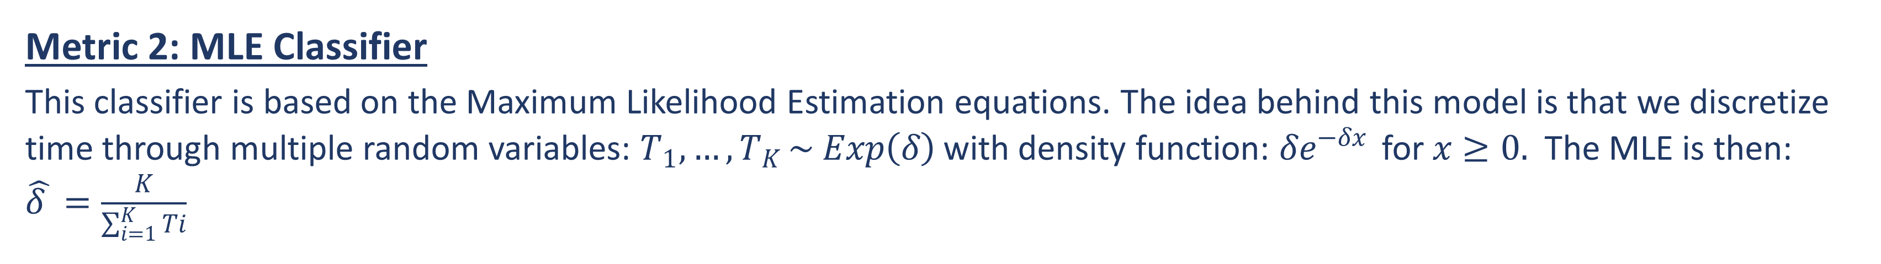
Wikipedia Changes and World Events WikipIndex
George Abi Younes, Amaury Combes, and Patryk Oleniuk
École Polytechnique Fédérale de Lausanne
Introduction
Metric 2: MLE Classifier
This classifier is based on the Maximum Likelihood Estimation equations. The idea behind this model is that we discretize time through multiple random variables: $T_{1},…,T_{K }\sim Exp\left(δ\right)$with density function: $δe^{−δx }$ for $x≥0.$ The MLE is then: $\hat{δ }=\frac{K}{\sum_{i=1}^{K}{Ti}}$
Main Results and Findings
Ever thought of how a country’s instability index is sized? Some people use Fragile States Index, others use Political Stability Indicator. We decided to disregard all of these fancy indicators and create our own using Wikipedia, literally.
We had an intuition towards the fact that the edits happening on a country’s Wikipedia page may contain an adequate amount of information to reflect on the country’s stability. Following that, resorting interchangeably to both Wikipedia and GDELT Event database, we started our journey of creating what we call the WikipIndex.
Metric 3: Wikipedia and Event Correlation
The correlation coefficient is calculated based on the Pearson Coefficient between two data series, which returns:
$r∈(0:1)$ - correlation coefficient and $p∈(0:1)$ - the probability that the data is uncorrelated even when having the correlation r. For each country we are saving the value $p×r$and use this value to counteract the fact that there are no events in the country and therefore stable Wikipedia will be highly correlated with stable events.
Figure 3: Wiki Instability [1st Metric] for Top 30 Countries
Methods
Metric 1: Prototype
Our first index is a rather intuition-based and simple. After fetching the Wikipedia page changes for a selected country and aggregate it monthly we use our outlier detector to classify the monthly edits as normal, significant, or extraordinary as follows:
${edits}_{extraordinary}:=edits≥coef×\overline{{edits}_{tot}}$
$${edits}_{significant}≔edits ≥0.7 ×coef×\overline{{edits}_{tot}}$$
and finally the index is calculated as follows:
R $=\frac{\sum{{edits}_{extraordinary}}+\sum{{edits}_{significant}}}{\sum{{edits}_{total}}}$
Figure 5: Wiki Instability [2nd Metric] for Top 30 Countries
Figure 6: Wiki Instability [3rd Metric] for Top 30 Countries
The above results show the three different metrics in action. We found the 3rd metric which uses the Wikipedia and Events correlation for classification, to be the best among the three, as it was the most consistent and had the least flagrant misclassifications.
Extraordinary
Significant
Figure 1: Metric 1 Outlier Detector in Action on Ukraine Wikipedia Page
Figure 2: Final Instability Indicator Overlay on World Map

